Slide 1
HLS LabC: Vitis Solver Library
LU Decomposition (Without Pivoting)
Team 3
Date: 2022/05/04
https://github.com/CHIHCHIEH-LAI/HLS/tree/main/Vitis_Solver_Library

Slide 2
Outline
Background Introduction (Bgd)
What is LU decomposition?
How to do LU decomposition?
Development Process (Dbg)
Simulation (Sts)
Code Explaination (Sys)
Function Hierarchy
Kernel functions
Findings and Performance Analysis (Opt)
Suggestion for Improvement (Imp)
Github Link (Git)

Slide 3
Background Introduction (Bgd)

Slide 4


What is LU Decomposition?
factors a matrix(A) as the product of a lower triangular matrix(L) and an upper triangular matrix(U)
can be viewed as the matrix form of Gaussian elimination
computers usually solve square systems of linear equations using LU decomposition
a key step when inverting a matrix or computing the determinant of a matrix
Notes:
LU 分解的本質是高斯消去法的一種表達形式，矩陣 L 記錄消去法化簡 A 的過程，矩陣 U 則儲存化簡結果。LU 分解的外表看似平淡無奇，但它常常被電腦用來解線性方程，逆矩陣與計算行列式，堪稱是最具實用價值的矩陣分解式之一。

Slide 5
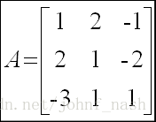
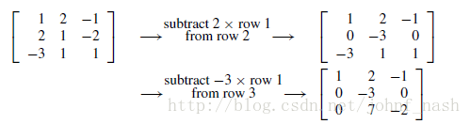


How to do LU Decomposition? Why Need Acceleration?
Computation Complexity: O(N³) !!!

Slide 6
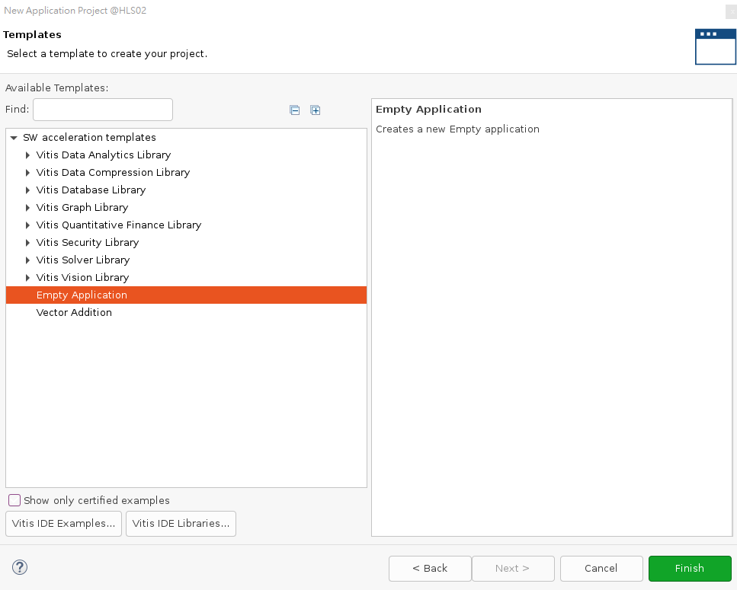
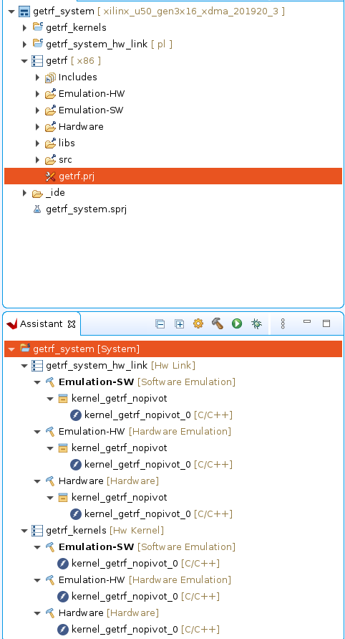
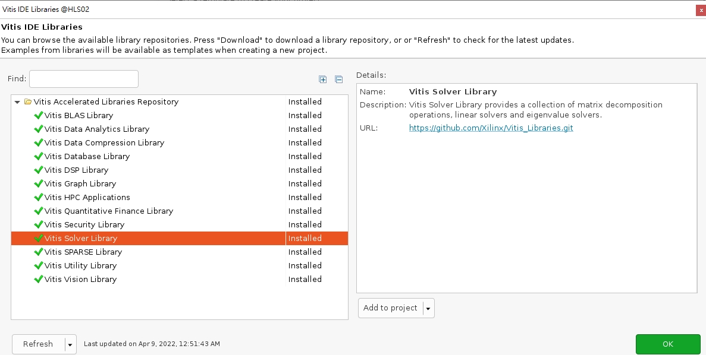
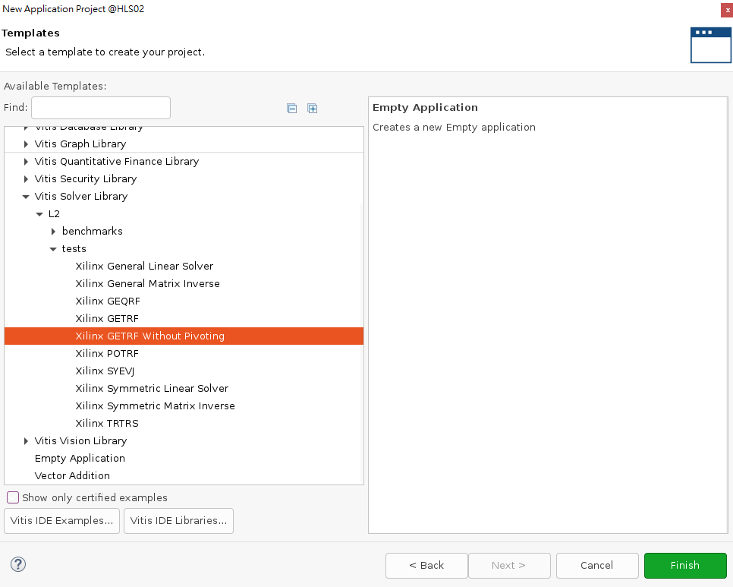
Development Process (Dbg)

Slide 7
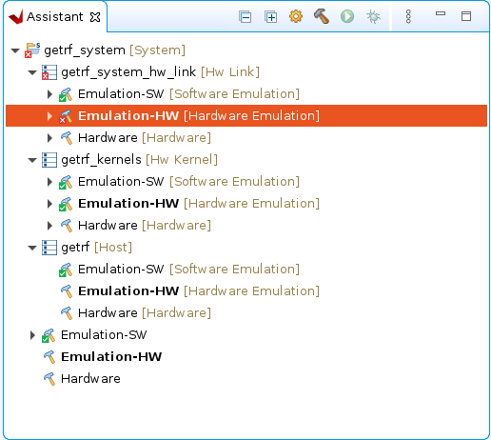
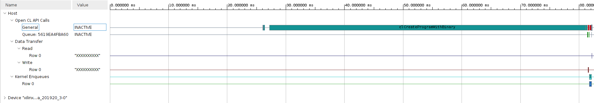
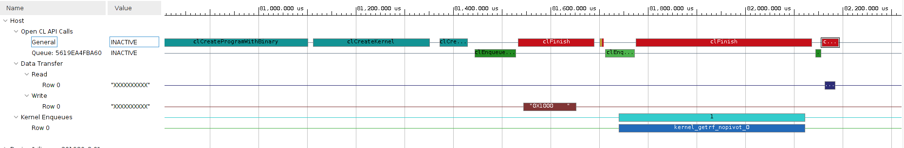
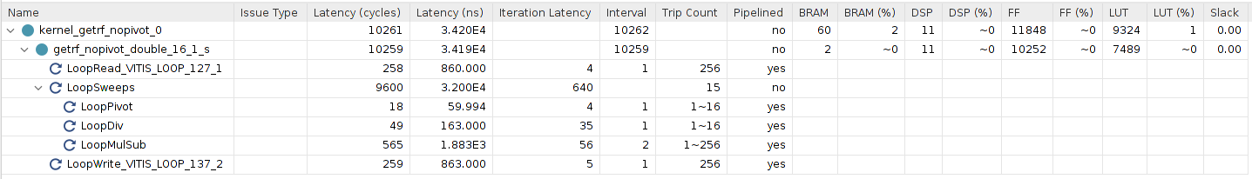
Simulation (Sts)

Slide 8
Code Explaination (Sys)

Slide 9
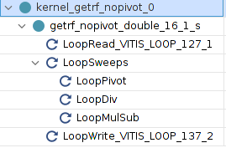
Kernel Function Hierarchy
Read
Compute
Write

Slide 10
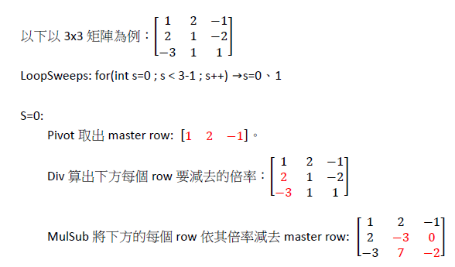
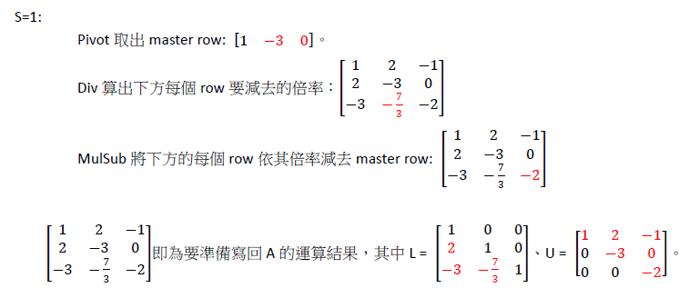

Slide 11
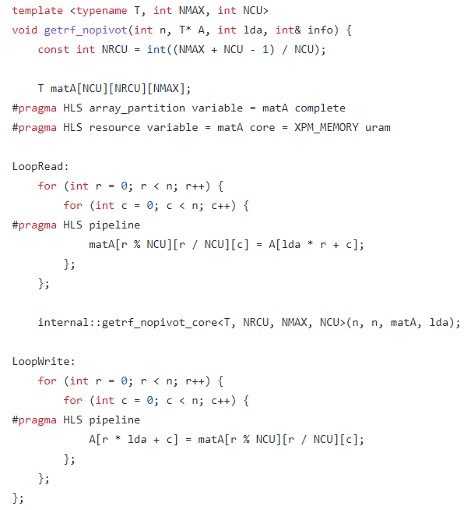
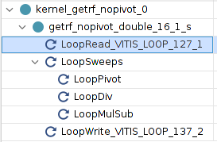
Kernel Functions
read matrix A

Slide 12
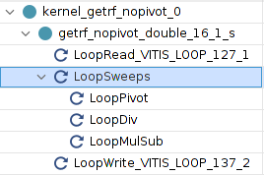
Kernel Functions
main function of LU decomposition

Slide 13
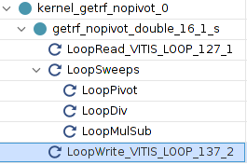
Kernel Functions
write matrix A back

Slide 14
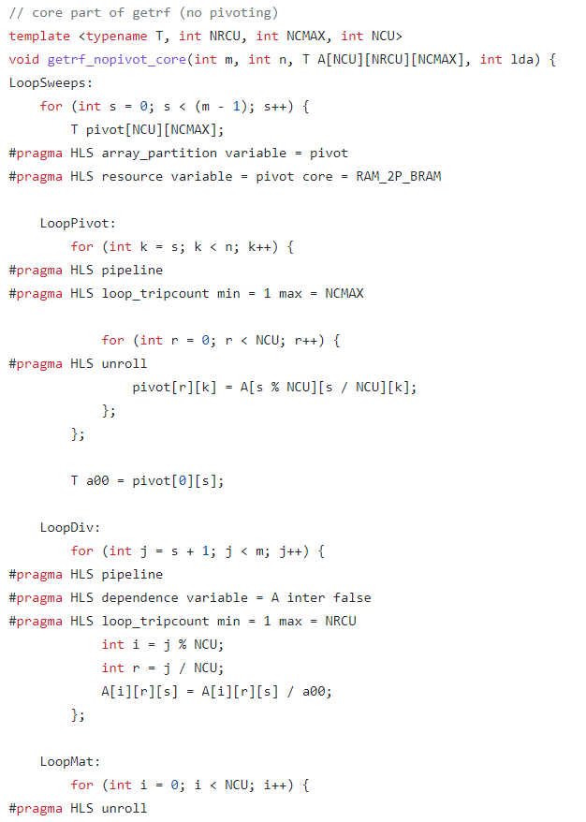
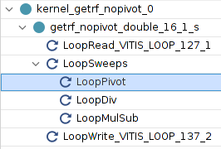
Kernel Functions
store pivot row that can be used later in LoopMulSub

Slide 15
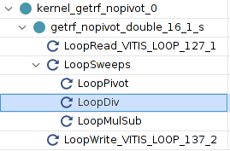
Kernel Functions
calculate L

Slide 16
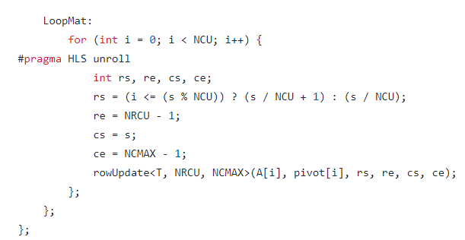
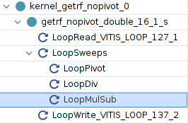
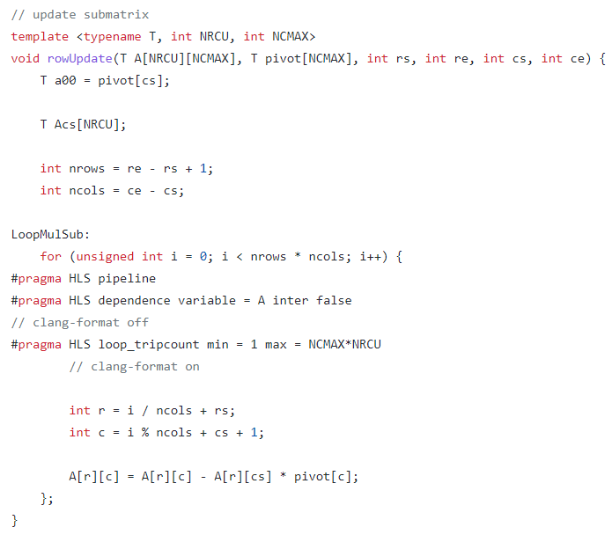
Kernel Functions
calculate U

Slide 17
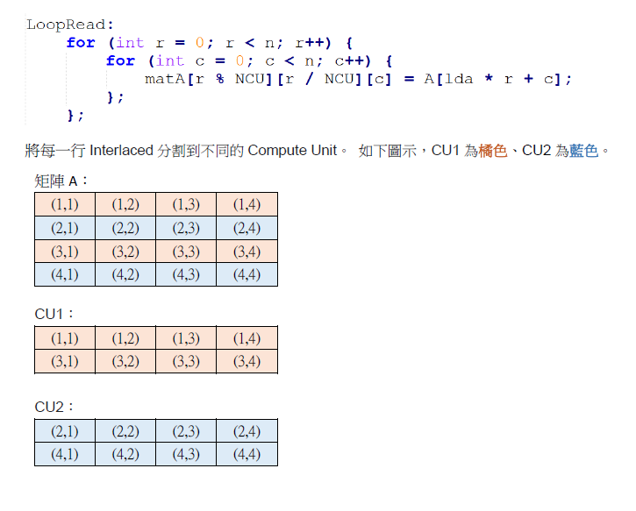
Parallelization

Slide 18
Findings & Performance Analysis (Opt)

Slide 19
合成結果
kernel參數：type = double, NRC = 16, NCU = 1
Latency時間占比
LoopRead: 2.51%
LoopSweeps: 93.58%
LoopWrite: 2.52%

Slide 20
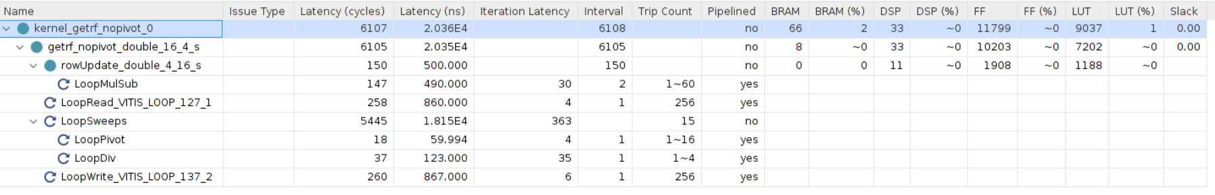
合成結果
kernel參數：type = double, NRC = 16, NCU = 4
Latency時間占比
LoopRead: 4.22%
LoopSweeps: 91.62%
LoopWrite: 4.26%

Slide 21
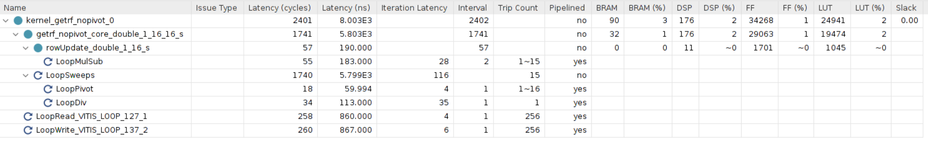
合成結果
kernel參數：type = double, NRC = 16, NCU = 16
Latency時間占比
LoopRead: 10.75%
LoopSweeps: 74.84%
LoopWrite: 10.83%

Slide 22
Suggestion for Improvement (Imp)

Slide 23
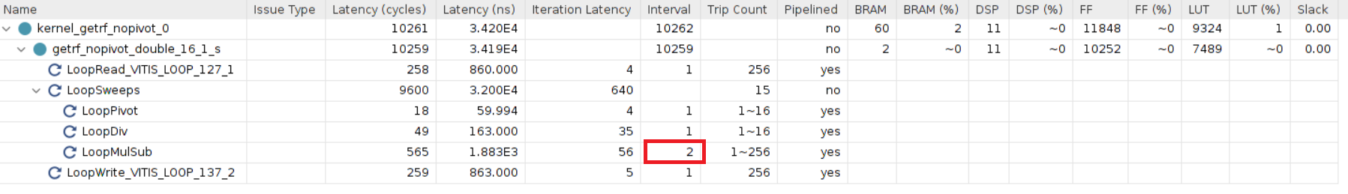
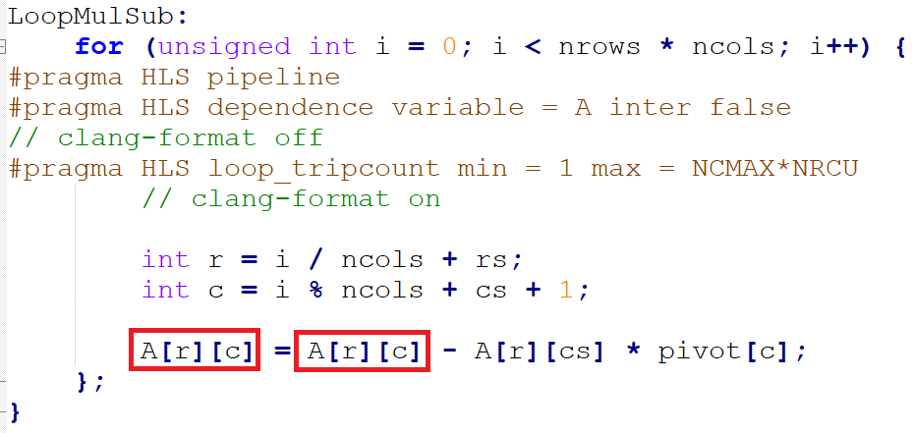
更改memory資源配置以提高速度
由於matA在一個loop內同時有讀寫兩個動作，因此需要增加port，而matA的partition已經開滿了，因此只能更動memory型態。

Slide 24
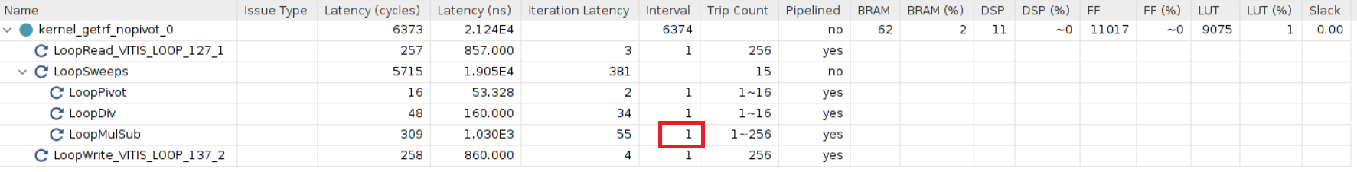

更改memory資源配置以提高速度
將有關matA的pragma移除，原先以為會變成以LUT構成的儲存單元，然而資源清單中可見除了BRAM從60增加到62以外，其他資源消耗皆有所下降。
因此推測matA的儲存方式變成BRAM。
解決LoopMulSub interval的問題後，整體速度提高61%！！

Slide 25
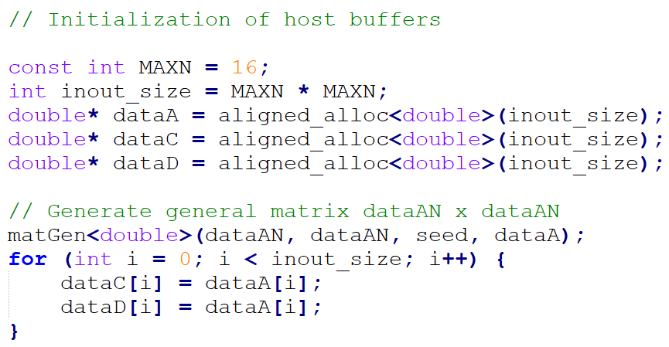
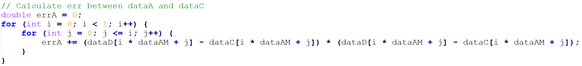
Correct Test Function
原先的test function 會將隨機產生的dataA複製兩份到dataC與dataD。
將dataA會送入kernel function做LU分解後比對dataD與dataC。
而dataD與dataC都是最初dataA的副本，因此無論如何比對都會一樣。
因此無法有效檢測kernel function的正確性！

Slide 26
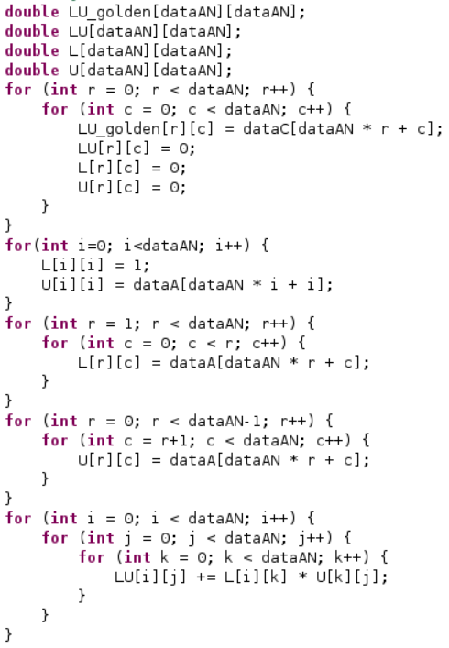
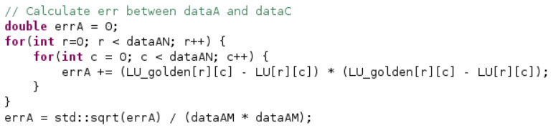
Correct Test Function
LU分解後的L與U兩個三角矩陣都儲存在dataA裡面
dataC則是最初dataA的副本
我們將L與U取出並相乘得到矩陣LU
再驗算L相乘U是否與原本的矩陣相同。
以達到驗證kernel function目的！

Slide 27
Github (Git):
https://github.com/CHIHCHIEH-LAI/HLS/tree/main/Vitis_Solver_Library

